Slide 1
Business Case for an Auction Company
Building the framework for successful LLM solutions
Notes:
This presentation is about creating a business case for an auction company. We will cover the necessary topics that will help us to understand how to create an LLM solution, the architecture, the exploratory analysis, deploying the solution, and securing the environment.

Slide 2
AI Full Project Approach (Part 1)
1 - Architecture / Design Patterns
1.1 Questions to ask when creating an LLM solution
2 - Business overview / Enterprise model
2.1 - How it is done today (LLM)
2.2 - Chosen architecture
2.3 - Why defining the architecture is so important
2.4 - LLM services
2.4.1 - Azure Open AI
2.4.2 - GCP Vertex
2.4.3 - Anthropic
3 - Exploratory analysis
3.1 - Notebook research (Using GPT Turbo vs GPT4o vs Gemini vs Anthorpic Claude)
3.2 - Comparing model results
3.3 - Can the business work with this? Is there any limitation?
3.4 - Decision log
Notes:
In this section, we will discuss the business overview of the auction company, including how LLM is done today, the chosen architecture, and LLM services such as Azure Open AI, GCP Vertex, and Anthropic. We will also discuss why defining the architecture is so important.

Slide 3
AI Full Project Approach (Part 2)
4 - Deploying the solution
4.1 – Best practices (API Gateway, Retry options, Prompt Engineering)
4.2 - Azure Functions - API Deploy
4.3 - Monetize your solution (Rapid API deploy)
5 - Securing the environment
5.1 - Enclosing the env using a Private Network
5.2 - Using a VM inside the VNet
5.3 - Using a proxy configuration
6 - Deploying the solution (Open-source approach) (Extra)
6.1 - Local machine
Notes:
In this section, we will discuss the business overview of the auction company, including how LLM is done today, the chosen architecture, and LLM services such as Azure Open AI, GCP Vertex, and Anthropic. We will also discuss why defining the architecture is so important.

Slide 4


Business Overview
The Business
Leaders in Brazil and Latin America, our technological platform guarantees transactions between buyers and sellers, bringing security, transparency and governance to the ecosystem. Everything a company no longer uses becomes an opportunity here: from real estate to oil platforms, from tractors to satellites that orbited the Earth. And this is just the beginning: we don’t stop because we move the market. And the more we grow, the more the economy circulates.
Notes:
In this section, we will discuss the business overview of the auction company, including how LLM is done today, the chosen architecture, and LLM services such as Azure Open AI, GCP Vertex, and Anthropic. We will also discuss why defining the architecture is so important.

Slide 5

Business Overview
Challenge
Brazil has 5570 cities that can submit invoices
Each city has his own invoice format
Notes:
In this section, we will discuss the business overview of the auction company, including how LLM is done today, the chosen architecture, and LLM services such as Azure Open AI, GCP Vertex, and Anthropic. We will also discuss why defining the architecture is so important.

Slide 6
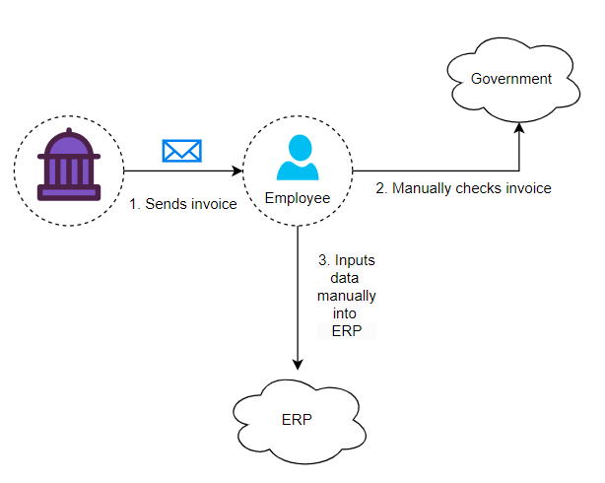
Business Overview
Challenge (How it is today)
Notes:
In this section, we will discuss the business overview of the auction company, including how LLM is done today, the chosen architecture, and LLM services such as Azure Open AI, GCP Vertex, and Anthropic. We will also discuss why defining the architecture is so important.

Slide 7
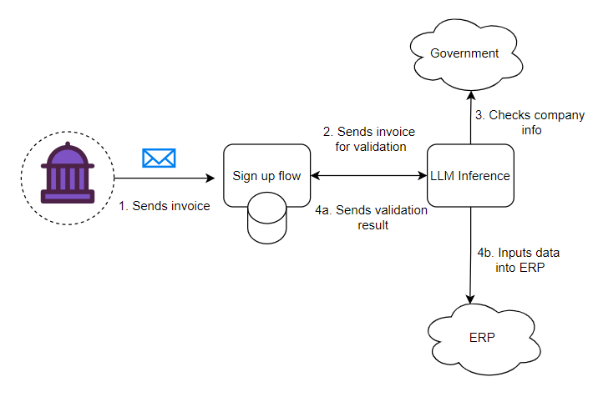
Business Overview
Challenge (How LLM will help)
Notes:
In this section, we will discuss the business overview of the auction company, including how LLM is done today, the chosen architecture, and LLM services such as Azure Open AI, GCP Vertex, and Anthropic. We will also discuss why defining the architecture is so important.

Slide 8
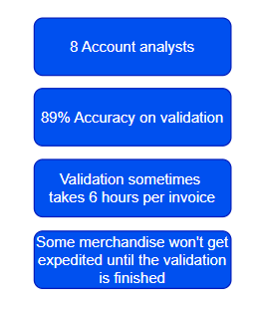
Business Overview
Challenge (Human limitations)
Notes:
In this section, we will discuss the business overview of the auction company, including how LLM is done today, the chosen architecture, and LLM services such as Azure Open AI, GCP Vertex, and Anthropic. We will also discuss why defining the architecture is so important.

Slide 9
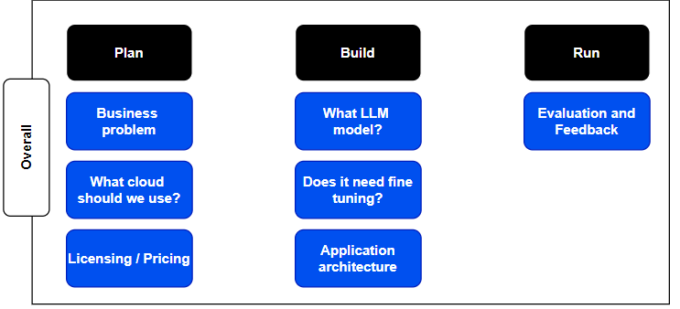
Architecture / Design Patterns
Notes:
When creating an LLM solution, there are several questions to ask to ensure that the architecture is designed correctly. In this section, we will discuss the different design patterns that can be used when creating an LLM solution.

Slide 10
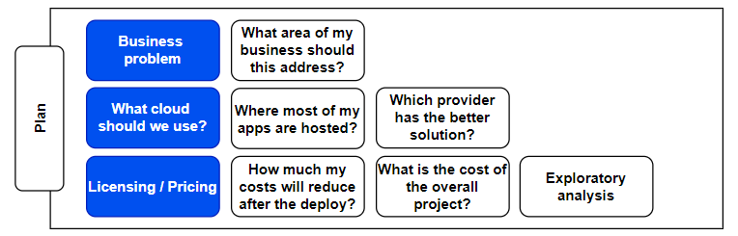
Architecture / Design Patterns
Notes:
When creating an LLM solution, there are several questions to ask to ensure that the architecture is designed correctly. In this section, we will discuss the different design patterns that can be used when creating an LLM solution.

Slide 11
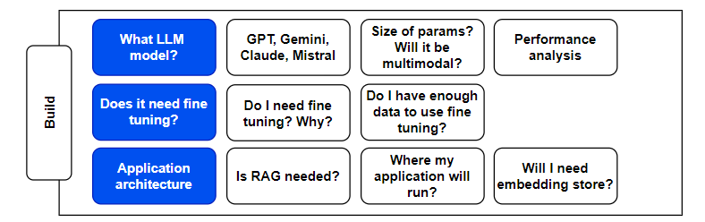
Architecture / Design Patterns
Notes:
When creating an LLM solution, there are several questions to ask to ensure that the architecture is designed correctly. In this section, we will discuss the different design patterns that can be used when creating an LLM solution.

Slide 12
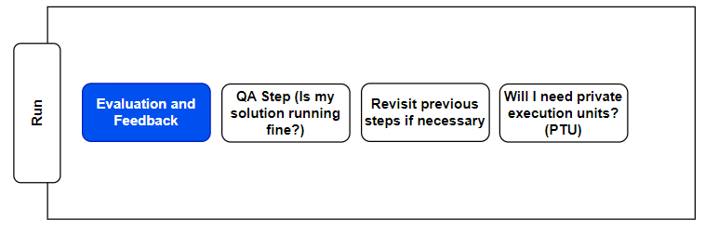
Architecture / Design Patterns
Notes:
When creating an LLM solution, there are several questions to ask to ensure that the architecture is designed correctly. In this section, we will discuss the different design patterns that can be used when creating an LLM solution.

Slide 13
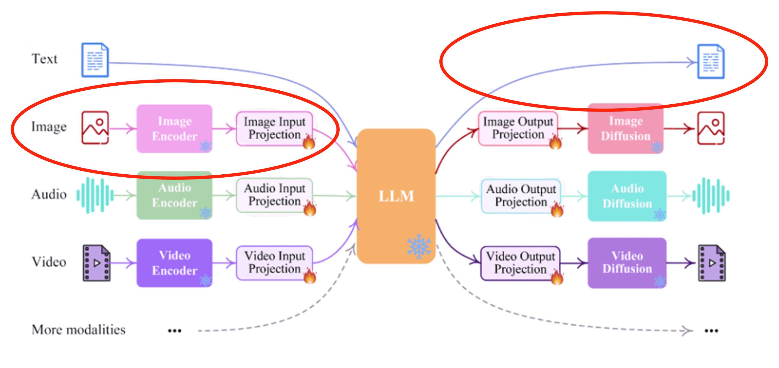
Architecture / Design Patterns
Reference: https://medium.com/@cout.shubham/exploring-multimodal-large-language-models-a-step-forward-in-ai-626918c6a3ec
Notes:
When creating an LLM solution, there are several questions to ask to ensure that the architecture is designed correctly. In this section, we will discuss the different design patterns that can be used when creating an LLM solution.

Slide 14
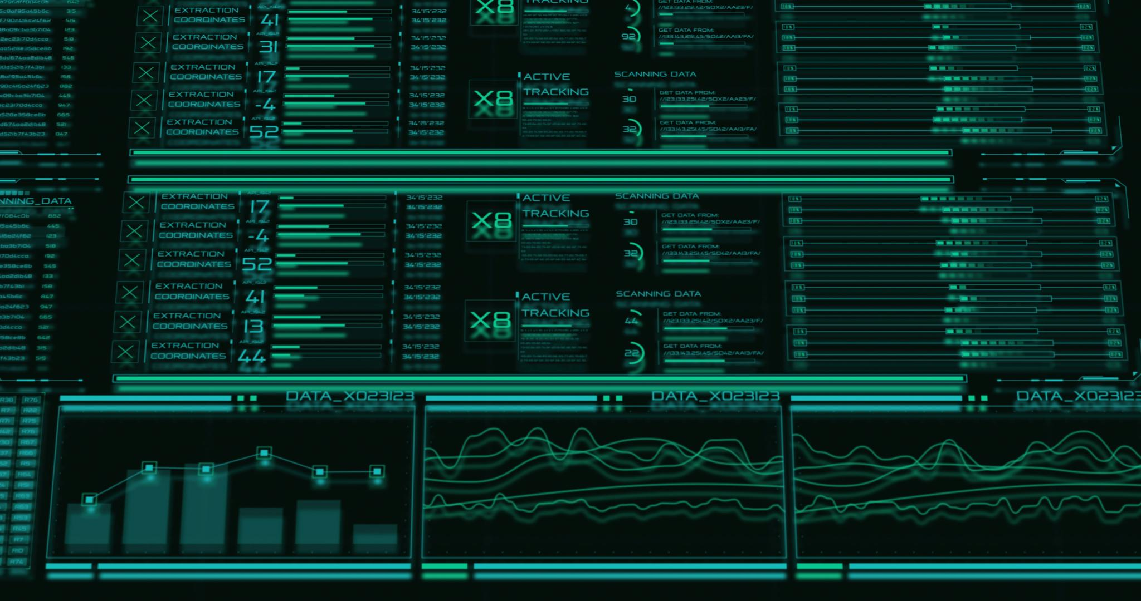
Exploratory Analysis
Premises
Process all invoices using 3 LLM providers
Based on the invoice description add 3 extra fields
Check if the results are good
Notes:
In this section, we will discuss the exploratory analysis, including Colab research, comparing model results, and decision log. We will also consider if the business can work with this and if there are any limitations.

Slide 15

LLM Providers
Perks
Easiest to use
Don't need to inform a region (the API Gateway takes care of the request)
Has the best model
Disadvantages
Only 2 SDKs (Python and Typescript)
Lacking topic of discussions on the Internet
Notes:
In this section, we will discuss how to deploy the solution, including Azure Functions - API Deploy and monetizing the solution with Rapid API.

Slide 16

LLM Providers
Perks
Easy to use
They manufacture their own chips (TPU) (easier to scale up)
Creators of Transformers and self-attention approach
Disadvantages
Lacking topic of discussions on the Internet
Bad habit of launching new models that have random hallucinations
Latest model not working for vision when using outside studio
Notes:
In this section, we will discuss how to deploy the solution, including Azure Functions - API Deploy and monetizing the solution with Rapid API.

Slide 17

LLM Providers
Perks
More material on the internet (StackOverflow, Medium and other resources)
Have integrated options like "Add you own data“
CSS of Microsoft is the best on the planet
Extra layer of security among APIs for the rest of the environment
Pioneer in the LLM area (together with Open AI)
The GOAT in AI tools
Disadvantages
More complex to use
Notes:
In this section, we will discuss how to deploy the solution, including Azure Functions - API Deploy and monetizing the solution with Rapid API.

Slide 18

LLM Providers
Notes:
In this section, we will discuss how to deploy the solution, including Azure Functions - API Deploy and monetizing the solution with Rapid API.

Slide 19
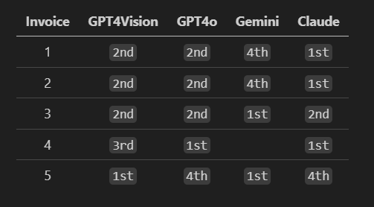
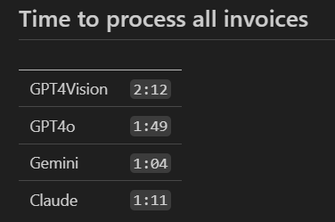
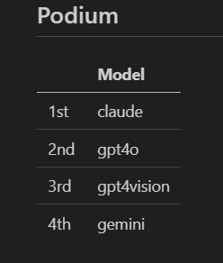
LLM Providers (PoC Final result)
I win…
Notes:
In this section, we will discuss how to deploy the solution, including Azure Functions - API Deploy and monetizing the solution with Rapid API.

Slide 20
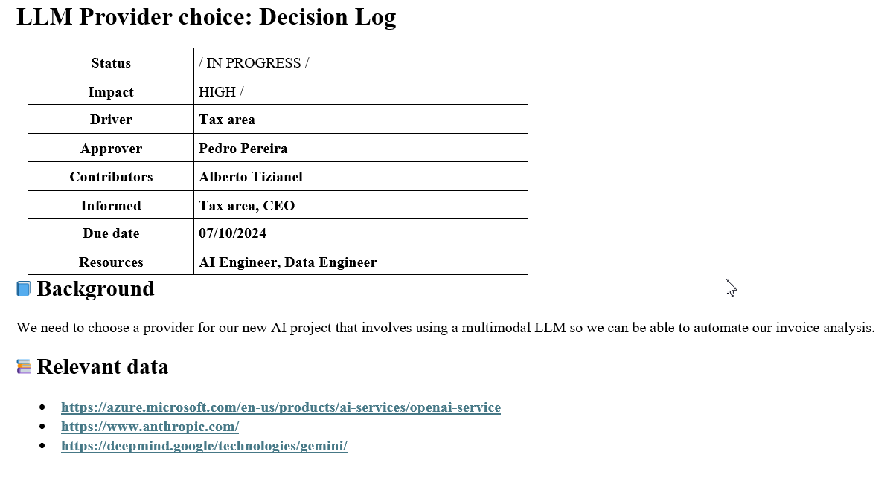
LLM Providers (Decision log)
Notes:
In this section, we will discuss how to deploy the solution, including Azure Functions - API Deploy and monetizing the solution with Rapid API.

Slide 21
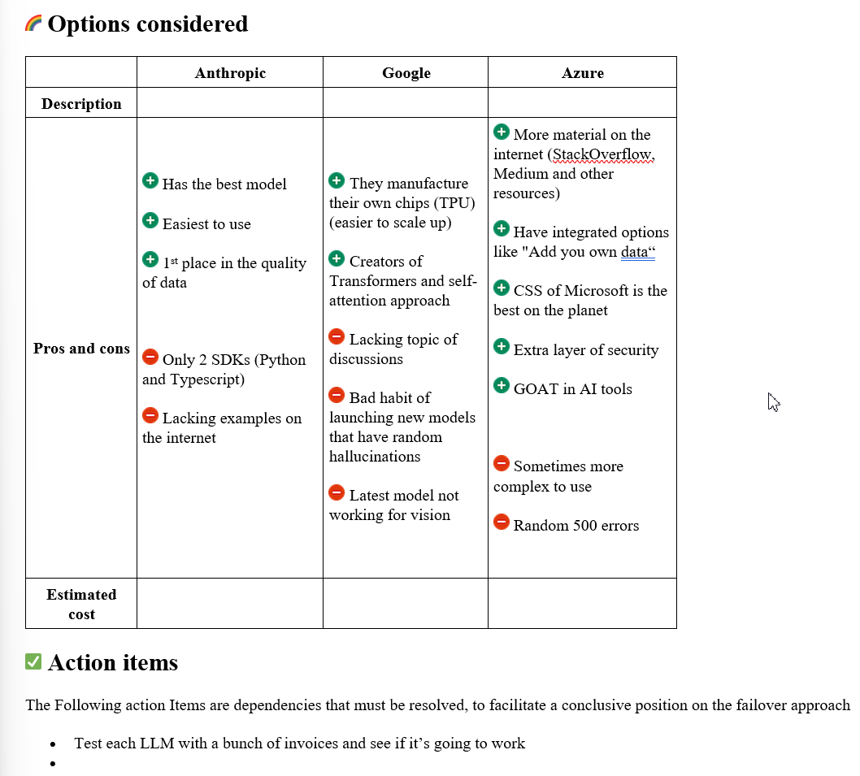
LLM Providers (Decision log)
Notes:
In this section, we will discuss how to deploy the solution, including Azure Functions - API Deploy and monetizing the solution with Rapid API.

Slide 22
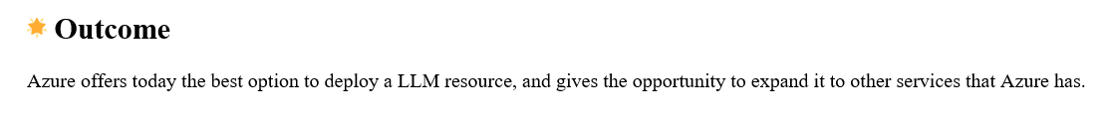
LLM Providers (Final result)
Sorry bro
But…
Notes:
In this section, we will discuss how to deploy the solution, including Azure Functions - API Deploy and monetizing the solution with Rapid API.

Slide 23
Thank you
Notes:
In this section, we will discuss how to deploy the solution, including Azure Functions - API Deploy and monetizing the solution with Rapid API.

